Slide 1




Slide 2
High Level Understanding of Transformers Architecture

Slide 3
Transformer Architecture
The original Transformer architecture is based on the encoder-decoder architecture.
Machine translation: where a sequence of words is translated from one language to another.
Output probabilities
Decoder
Encoder
Inputs
Output
(shifted right)

Slide 4
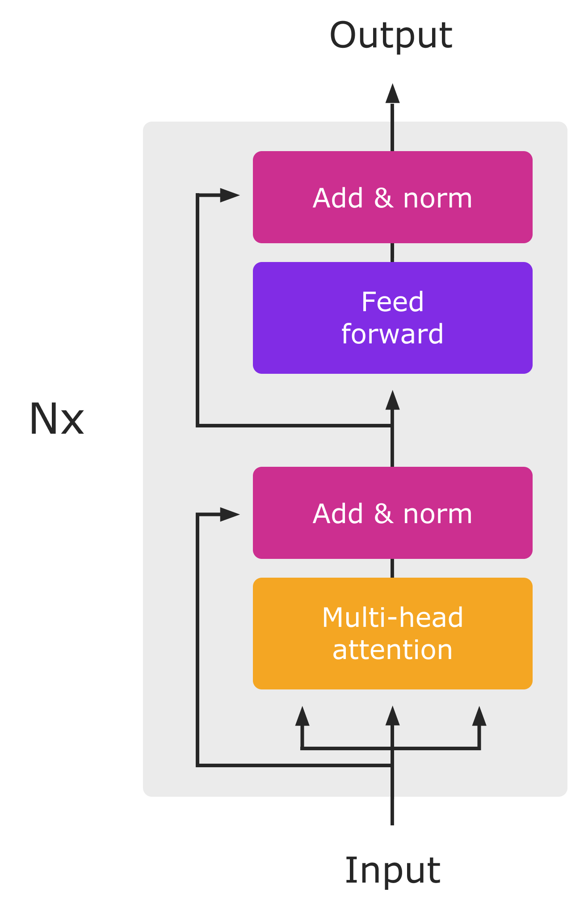
The Encoder
Converts an input sequence of tokens into a sequence of embedding vectors, often called the hidden state or context..
context
Encoder
Inputs

Slide 5
The Decoder
Uses the encoder’s hidden state to iteratively generate an output sequence of tokens, one token at a time.
Token 1
Decoder
Encoder
context
Inputs

Slide 6
The Decoder
Uses the encoder’s hidden state to iteratively generate an output sequence of tokens, one token at a time.
Token 1,Token 2
Decoder
Encoder
context
Inputs
Token 1

Slide 7
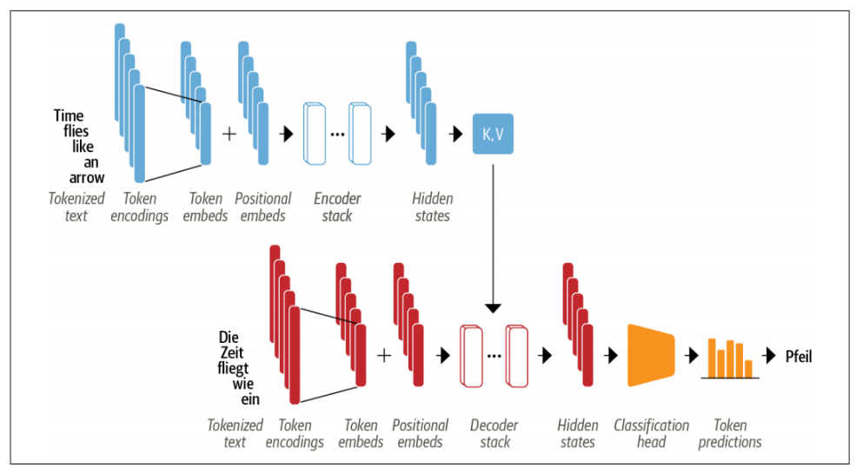
How does the Transformer work ?
The input text is tokenized and converted to token embeddings.
Add positional embeddings that contain positional information for each token.
The positional embeddings are passed to encoding stack.
The output of encoding stack feed into decoder stack.
Transformers
are
+
…
K,V
great
Token Embeddings
Positional Encoding
Encoding stack
Hidden state
…
transformer
Figure adapted from Tunstall, von Werra, & Wolf, 2022, p. 58
Classification
head
Decoder stack
Hidden state
Token Prediction

Slide 8
How does the Transformer work ?
The input text is tokenized and converted to token embeddings.
Add positional embeddings that contain positional information for each token.
The positional embeddings are passed to encoding stack.
The output of encoding stack feed into decoder stack.
Transformers
are
+
…
K,V
great
Token Embeddings
Positional Encoding
Encoding stack
Hidden state
Transformers
+
…
est
Figure adapted from Tunstall, von Werra, & Wolf, 2022, p. 58
Classification
head
Token Embeddings
Positional Encoding
Decoder stack
Hidden state
Token Prediction

Slide 9
How does the Transformer work ?
The input text is tokenized and converted to token embeddings.
Add positional embeddings that contain positional information for each token.
The positional embeddings are passed to encoding stack.
The output of encoding stack feed into decoder stack.
Transformers
are
+
…
K,V
great
Token Embeddings
Positional Encoding
Encoding stack
Hidden state
Transformers
+
…
super
est
Figure adapted from Tunstall, von Werra, & Wolf, 2022, p. 58
Classification
head
Token Embeddings
Positional Encoding
Decoder stack
Hidden state
Token Prediction

Slide 10
How does the Transformer work ?
The input text is tokenized and converted to token embeddings.
Add positional embeddings that contain positional information for each token.
The positional embeddings are passed to encoding stack.
The output of encoding stack feed into decoder stack.
Transformers
are
+
…
K,V
great
Token Embeddings
Positional Encoding
Encoding stack
Hidden state
Transformers
+
…
EOS
est
super
Figure adapted from Tunstall, von Werra, & Wolf, 2022, p. 58
Classification
head
Token Embeddings
Positional Encoding
Decoder stack
Hidden state
Token Prediction

Slide 11
Transformers Families
The original Transformer architecture is designed for sequence-to-sequence tasks.
Transformers est super
Decoder
Encoder
Transformers are great
Transformers est

Slide 12
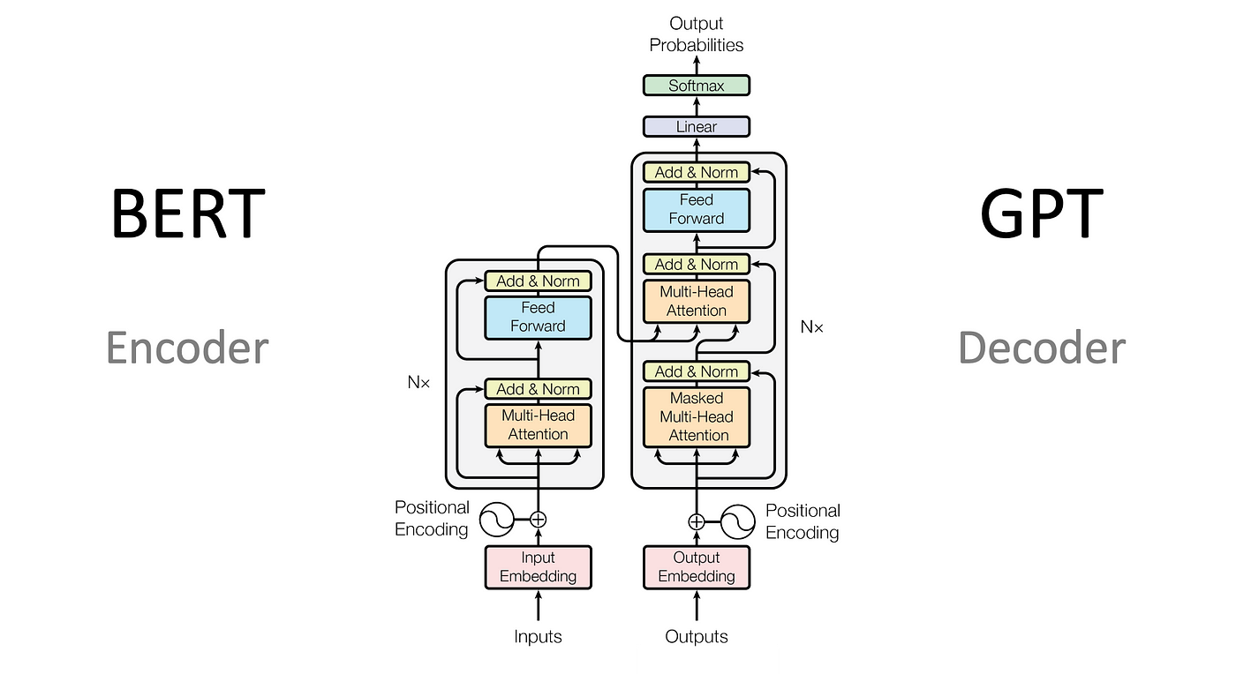
Transformers Families
The original Transformer architecture is designed for sequence-to-sequence tasks.
Outputs
Decoder
Outputs
Encoder
Inputs
Inputs
T5

Slide 13
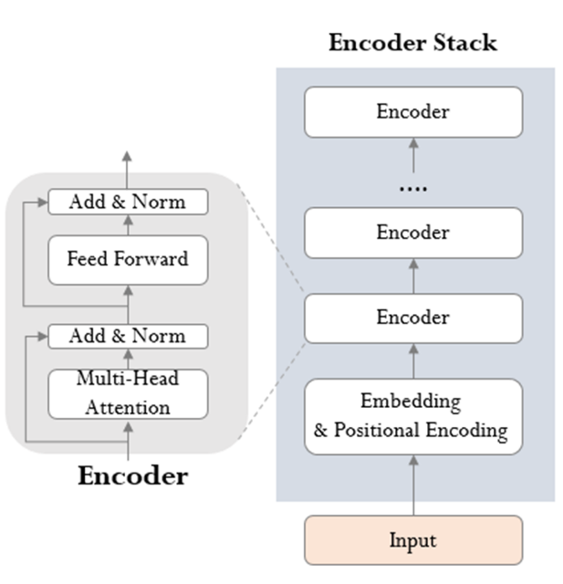
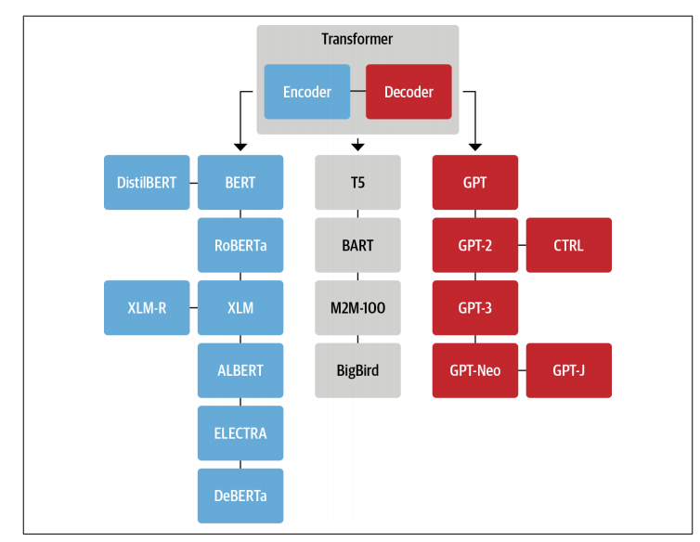
The Encoder-only or Autoencoder
These models convert an input sequence of text into a numerical representation.
Usage tasks: text classification or named entity recognition.
bidirectional attention :architecture depends both on the left and the right contexts.
Examples: Bert and Roberta.
(Tunstall, von Werra, & Wolf, 2022, p. 79)

Slide 14
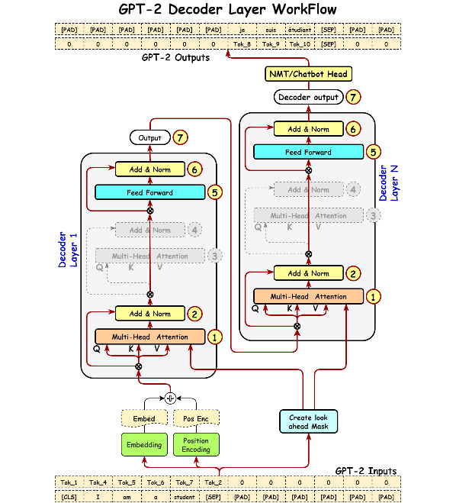
The Decoder-only or Autoregressive
These models will autocomplete the sequence by iteratively predicting the most probable next word.
causal or autoregressive attention: architecture depends on the left context (only the context before the predicted word ) .
Examples: GPT Family.
(Tunstall, von Werra, & Wolf, 2022, p. 79)

Slide 15
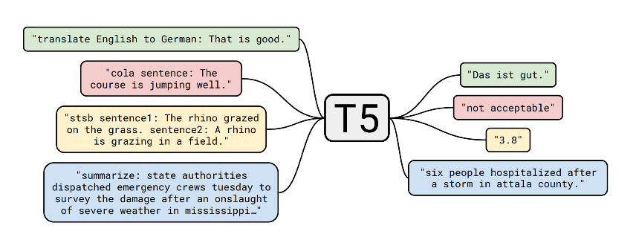
The encoder-decoder or sequence to sequence
These are used for modeling complex mappings from one sequence of text to another
Usage tasks: machine translation and summarization tasks.
Examples: T5 and big bird transformers.
(Tunstall, von Werra, & Wolf, 2022, p. 79)

